Slide 1
Descriptive Statistics

Slide 2
Descriptive Statistics
Descriptive statistics are used to describe the basic features of the data in a study.
Descriptive statistics avoid inference but, they help us to get a feel of the data.
In Descriptive statistics we generate the statements based on the data we have and present the data in more meaningful ways.
Quantitatively describing the data in three diff ways :-
Graphical Representation
Tabular representation
Summarized representation

Slide 3
Which Group is Smarter?
Class A-- IQs of 13 Students
102, 115,128,109,131,89,98,106,140,119,93,97,110
Class B-- IQs of 13 Students
127,162,131,103,96,111,80,109,93,87,120,105,109
Class A-- Average IQ Class B-- Average IQ
110.54 110.23
They’re roughly the same!
With a summary descriptive statistic, it is much easier to answer our question.

Slide 4
Summarizing data through numbers
Measures of Central Tendency:
  The data values for most numerical variables tend to group around a specific value
  Measure of centre help us to describe what extent this pattern holds for a specific numerical variable
  Three commonly-used measures of centre:
    (a) Mean (also known as the arithmetic mean or average)
    (b) Median
    (c) Mode
Measures of Dispersion:
  A measure of spread, sometimes also called a measure of dispersion or measure of variability is used to describe the variability in a sample or population.
  It is usually used in conjunction with measure of central tendency, such as the mean or median, to provide an overall description of a set of data.
    (a) Range
    (b) Variance
    (c) Standard Deviation
Measures of Distributions:
    (f) Skewness
    (g) Kurtosis

Slide 5
Measures of Central Tendency
A measure of central tendency is a descriptive statistic that describes the average, or typical value of a set of scores.
It is also defined as a single value that is used to describe the “center” of the data.
There are three common measures of central tendency:
  Mean
  Median
  Mode
** The mean, median and mode are all valid measures of central tendency, but under different conditions, some measures of central tendency become more appropriate to use than others.

Slide 6
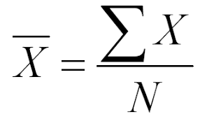
MEAN
The mean (or average) is the most popular and well known measure of central tendency.
The mean is the average of the numbers. It is easy to calculate: add up all the numbers, then divide by how many numbers there are. In other words it is the sum divided by the count.
Σ X= the sum of numbers
N = Number of data

Slide 7
MEAN
Example 1 :
Scores of 15 students in Mathematics quiz consist of 25 items. The highest score is 25 and the lowest score is 10.
Here are the scores: 25,20,18,18,17,15,15,14,14,13,12,12,10,10.
Find the mean in the following scores.
x(Scores)
25 14
20 13
18 13
18 12
17 12
15 10
10
14
Sum of scores(Σ X) 228
Number of students(N) 15
Mean => 228/15 15.2

Slide 8
MEAN
Example 2 :
Let’s say you wanted to work for a small law firm that paid an average salary of over $73,000 to its 11 employees. You might think there’s a good chance you’ll land a great paying job. But take a closer look at how the average is calculated for those eleven employees:
  Employee Salary
  Samuel $28,000
  Candice $17,400
  Thomas $22,000
  Ted $300,000
  Carly $300,000
  Shawanna $20,500
  Chan $18,500
  Janine $27,000
  Barbara $21,000
  Anna $29,000
  Jim $20,000
Average (Mean) =>
($28,000 + $17,400 + $22,000 + $300,000 + $300,000 + $20,500 + $18,500 + $27,000 + $21,000 + $29,000 + $20,000) / 11
=> $73,000
See how the “average” can be misleading?

Slide 9
MEDIAN
The median is the value separating the higher half from the lower half of a data sample.
For a data set, it may be thought of as the "middle" value.
The “Median” of a dataset is dependent on whether the number of elements in the data set is odd or even. Calculation:
  First reorder the data set from the smallest to the largest.
  Mark off the high and low values until you reach the middle.
  If there 2 middles, add them and divide by 2.

Slide 10
MEDIAN
Examples:
Odd Number of Elements
  Dataset 2,5,9,3,5,4,7
  Reordered 2,3,4,5,5,7,9
  Median 5
Even Number of Elements
  Dataset 2,5,9,3,5,4
  Reordered 2,3,4,5,5,9
  Median (4+5)/2 => 4.5

Slide 11
MODE
The mode is simply the number which appears most often.
Example:
In {6, 3, 9, 6, 6, 5, 9, 3} the Mode is 6, as it occurs most often.
More Than One Mode
We can have more than one mode.
Example: In {1, 3, 3, 3, 4, 4, 6, 6, 6, 9} 3 appears three times, as does 6.
So there are two modes: at 3 and 6
Having two modes is called "bimodal".
Having more than two modes is called "multimodal".

Slide 12

When to use Mode
Suppose we have a road as shown in picture at right side. We have to decide where to place the garbage can on the road. To determine that place, a survey is conducted and the following results are obtained.
  1.40 % of people said the garbage can can be placed at 25th meter.
  2.45 % of people said the garbage can can be placed at 75th meter.
  3. 15% of people said the garbage can can be placed anywhere between 0-100.
In this case if we calculate the mean and median, it will give an central value, which no one preferred.
Thus mean and median do not appear more interesting to us. Whereas the Mode will give the value which is preferred by most of the people.
Thus in this type of scenario Mode is useful.

Slide 13
Measures of Dispersion

Slide 14
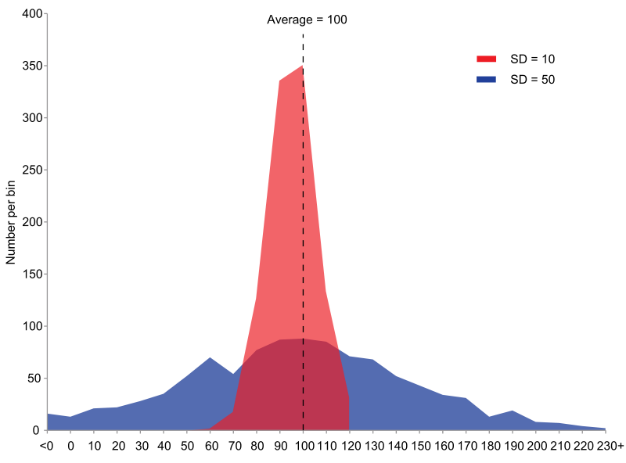
Measure of Dispersion
The measure of dispersion shows the scatterings of the data.
It tells the variation of the data from one another and gives a clear idea about the distribution of the data.
The measure of dispersion shows the homogeneity or the heterogeneity of the distribution of the observations.

Slide 15
Range
A range is the most common and easily understandable measure of dispersion.
It is the difference between two extreme observations of the data set.
If X_{max} and X_{min} are the two extreme observations then
                Range = X _{max} – X _{min}
Merits of Range
It is the simplest of the measure of dispersion
Easy to calculate
Easy to understand
Independent of change of origin
Demerits of Range
It is based on two extreme observations. Hence, get affected by fluctuations
A range is not a reliable measure of dispersion
Dependent on change of scale

Slide 16

Variance
The Variance is a measure of how spread out numbers are.
The average of the squared differences from the Mean.
Variance is denoted by the Greek letter sigma(σ2)
Where,
σ2 = Variance
x = Item given in the data
x̅ = Mean of the data
n = Total number of items.

Slide 17

Standard Deviation
Deviation just means how far from the normal.
Standard deviation is square root of the variance.
The symbol for Standard Deviation is σ (the Greek letter sigma).
where
µ= The mean of the xi
Xi= Each of the values of the data
N= Number of data points

Slide 18
Measures of Distributions

Slide 19
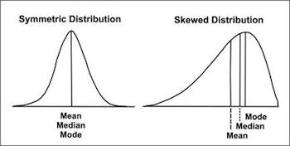
Skewness
Skewness in statistics represents an imbalance and asymmetry from the mean of a data distribution.
In a symmetric bell curve, the mean, median, and mode are all the same value. But in a skewed distribution, the mean, median, and mode are all different values.

Slide 20
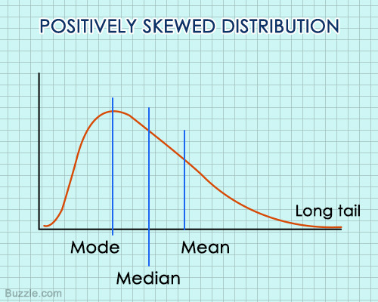
Right Skewed distribution
A positively skewed distribution is one in which the tail of the distribution shifts towards the right, i.e., it has a tail on the positive direction of the curve.
The reason for this skewness is that the mass of the distribution occurs on the left side of the positively skewed distribution curve. This means that most values of the distribution occur on the left side.

Slide 21
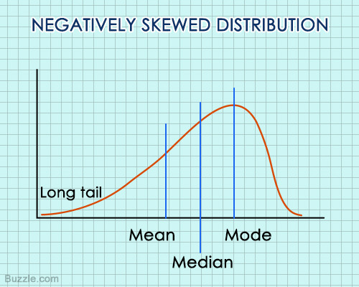
Left Skewed Distribution
A left skewed distribution is sometimes called a negatively skewed distribution because it’s long tail is on the negative direction on a number line.
In such a distribution, the left tail is the part where the extreme values occur, and these values are smaller in magnitude. Since the mean tends to shift towards the extreme values, it is smaller in magnitude. Both the mean and median are lower than the mode, and in most of such cases, the mean will also be lesser than the median.

Slide 22
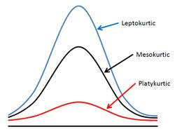
Kurtosis
Kurtosis refers to a measure of the degree to which a given distribution is more or less ‘peaked’, relative to the normal distribution.
In this regard, we have 3 categories of distributions:
  Leptokurtic
  Mesokurtic
  Platykurtic
Leptokurtic:
  a “positive” or tall and thin distribution
  (fatter tails).
  if the value is more than 3.
Mesokurtic:
  A normal distribution.
  if the value is 3.
Platykurtic:
  a “negative” or flat and wide distribution
  (thin tails).
  if value of kurtosis is less than 3.

Slide 23
THANK YOU FOR YOUR
ATTENTATION

